Slide 1
Chapter 3
Growth of Functions
C.K. Huang

Slide 2
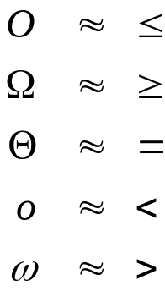
Overview
A way to describe behavior of functions in the limit. We’re studying asymptotic(漸近) efficiency.
Describe growth of functions.
Focus on what’s important by abstracting away low-order terms and constant factors.
How we indicate running times of algorithms.
A way to compare “sizes” of functions:

Slide 3
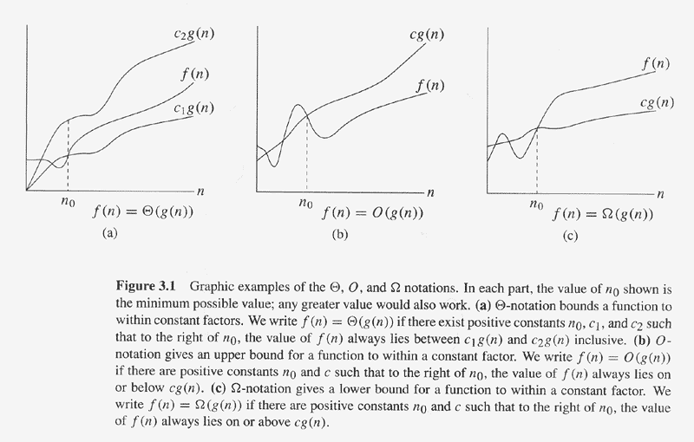
Graphic Examples

Slide 4
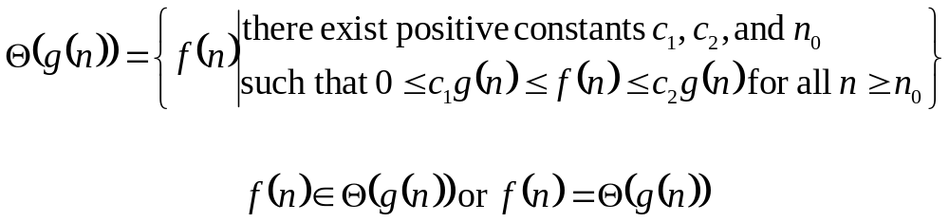
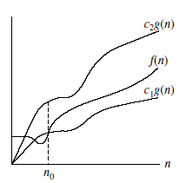
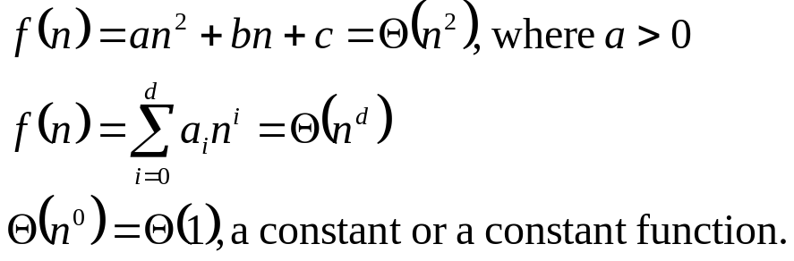
Θ-notation
g(n) is an asymptotically tight bound for f(n)
f(n) is asymptotically nonnegative

Slide 5
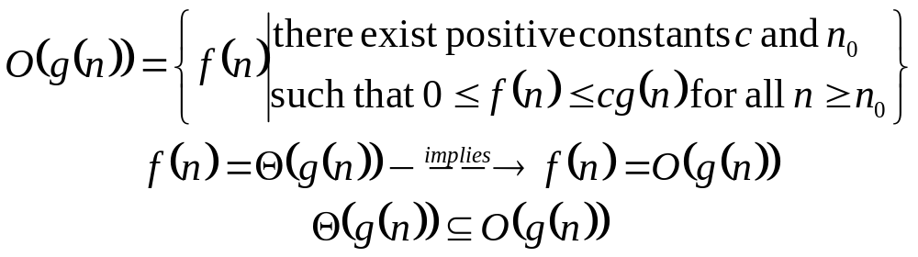
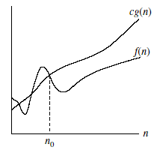
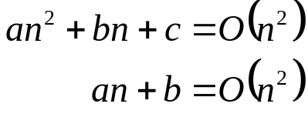
Ο-notation
“big-oh of g of n”
Asymptotically upper bound → worst-case running time
Θ-notation is a stronger notion than Ο-notation
Using Ο-notation, we ca often describe the running time of an algorithm merely by inspecting the algorithm’s overall structure.
  Insertion-sort

Slide 6
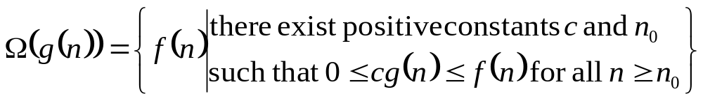
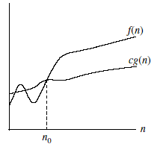
Ω-notation
“big-omega of g of n”
Asymptotically lower bound → best-case running time
Theorem:
f(n) = Θ(g(n)) if and only if f(n) = Ω(g(n)) and f(n) = O(g(n))

Slide 7
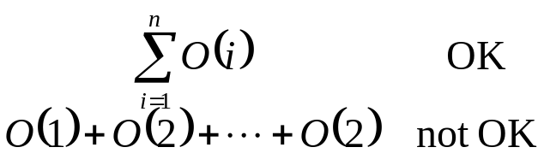
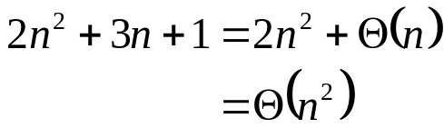
Asymptotic Notation in Equations
On right-hand side:
  2n² + 3n + 1 = 2n² + Θ(n)
  2n² + 3n + 1 = 2n² + f(n)
  for some f(n) ∈ Θ(n)
  in this case, f(n) = 3n + 1
On left-hand side:
  No matter how the anonymous functions are chosen on the left-hand side, there is a way to choose the anonymous functions on the right-hand side to make the equation valid.
  2n² + Θ(n) = Θ(n²)
  2n² + f(n) = g(n)
  for any function f(n) ∈ Θ(n),
  there exists a function g(n) ∈ Θ(n²)

Slide 8
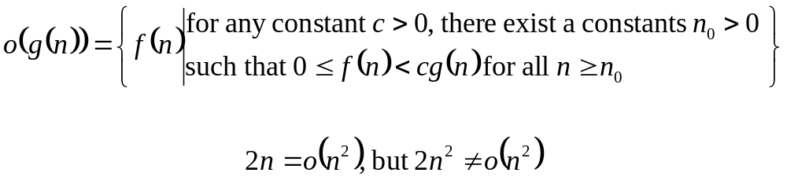
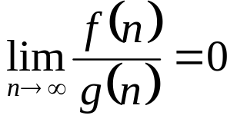
ο-notation
“little-oh of g of n”
An upper bound that is not asymptotically tight.

Slide 9
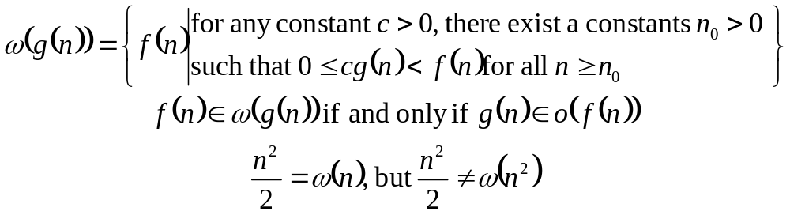
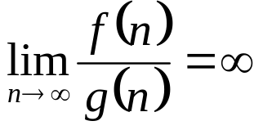
ω-notation
“little-omega of g of n”
A lower bound that is not asymptotically tight.

Slide 10
Comparison of Functions
– Relational Properties
Transitivity
  f(n) = Θ(g(n)) and g(n) = Θ(h(n)) ⇒ f(n) = Θ(h(n))
  (same for O, Ω, o, ω)
Reflexivity
  f(n) = Θ(f(n)) (same for O, Ω)
Symmetry
  f(n) = Θ(g(n)) if and only if g(n) = Θ(f(n))
Transpose symmetry
  f(n) = O(g(n)) if and only if g(n) = Ω (f(n))
  f(n) = o(g(n)) if and only if g(n) = ω(f(n))

Slide 11
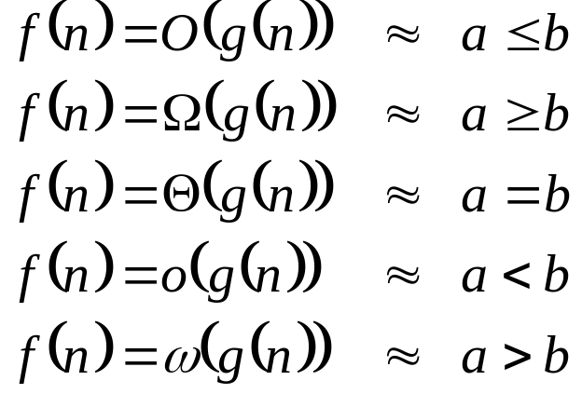

Comparison of Functions
– Comparisons
f(n) is asymptotically smaller than g(n)
g(n) is asymptotically larger than f(n)
No trichotomy(三一律)

Slide 12
Standard Notations
– Monotonicity
f(n) is monotonically increasing if m ≤ n ⇒ f(m) ≤ f(n).
f(n) is monotonically decreasing if m ≥ n ⇒ f(m) ≥ f(n).
f(n) is strictly increasing if m < n ⇒ f(n) < f(n).
f(n) is strictly decreasing if m > n ⇒ f(n) > f(n).

Slide 13
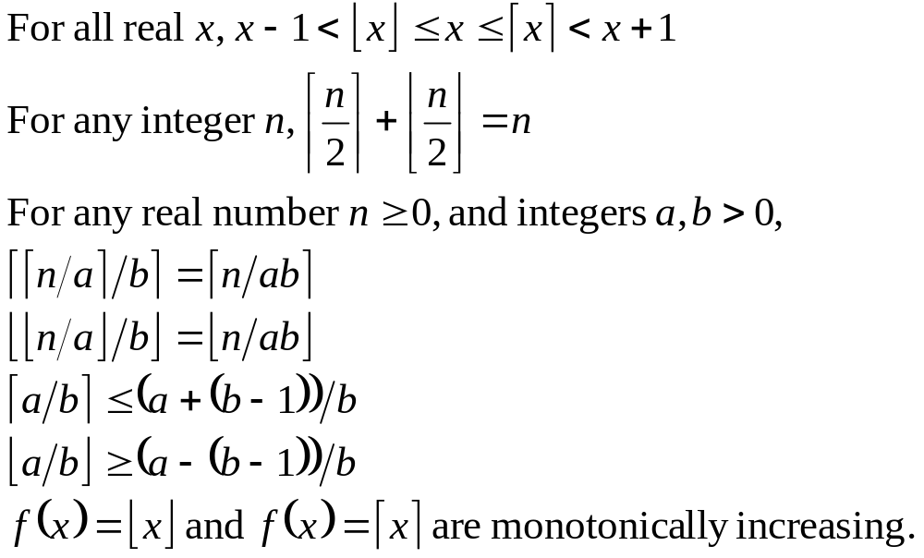
Standard Notations
– Floors and Ceilings

Slide 14
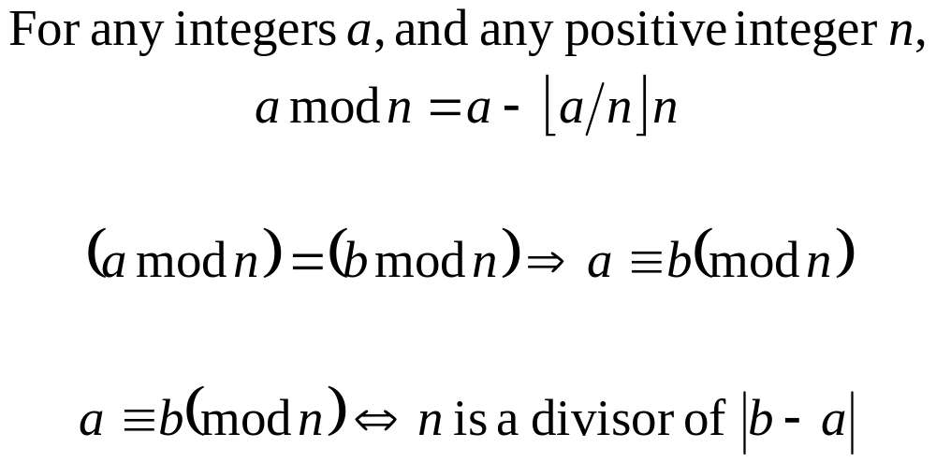
Standard Notations
– Modular Arithmetic
Remainder or residue

Slide 15
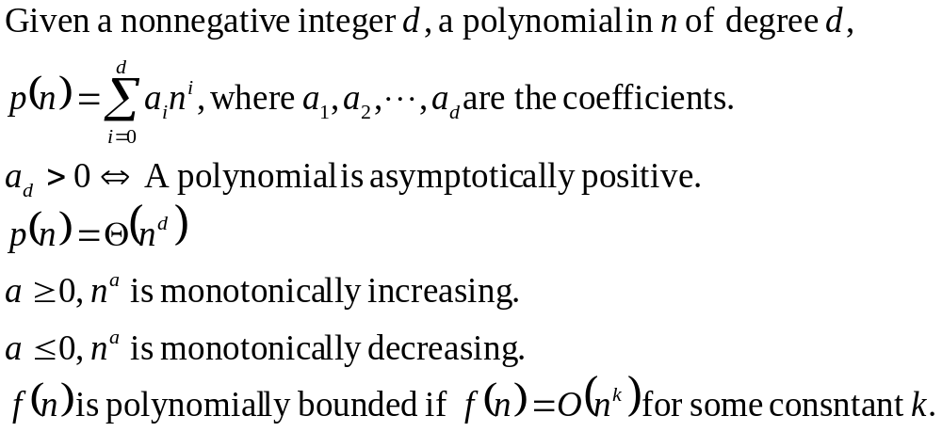
Standard Notations
– Polynomials

Slide 16
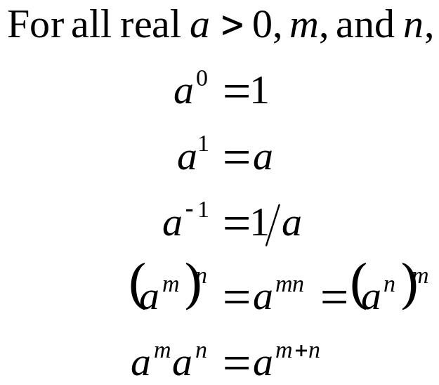
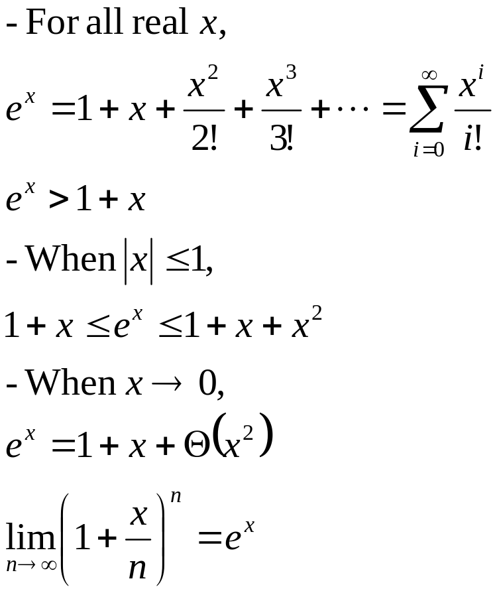
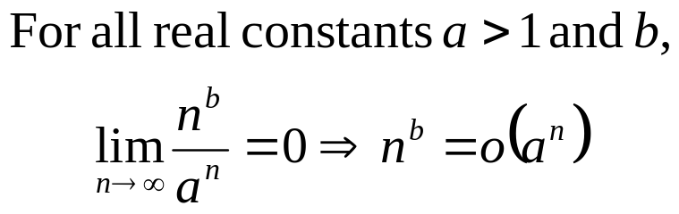
Standard Notations
– Exponentials

Slide 17
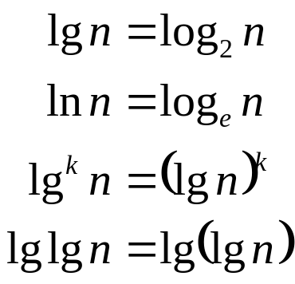
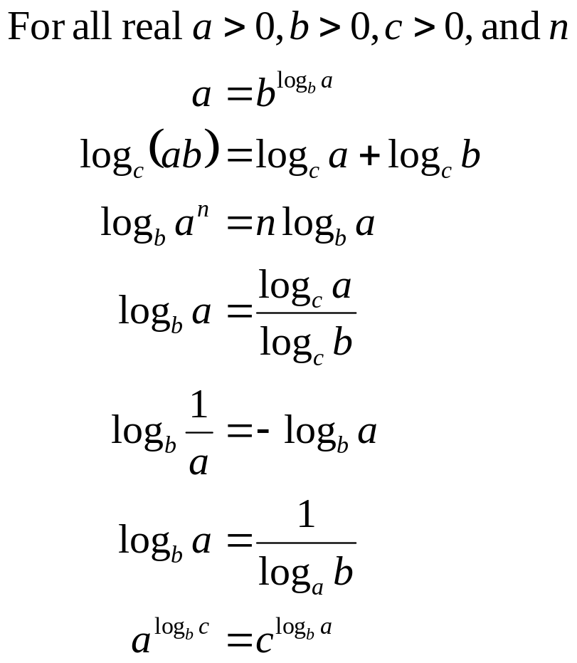
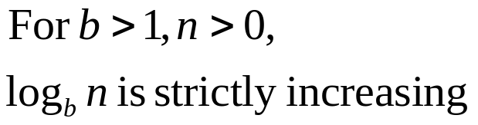
Standard Notations
– Logarithms

Slide 18
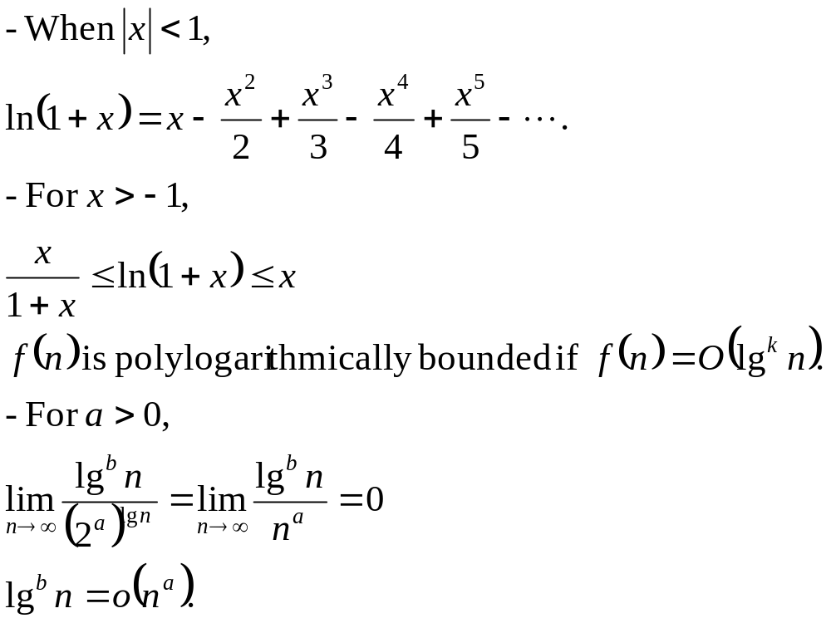
Standard Notations
– Logarithms (2)

Slide 19
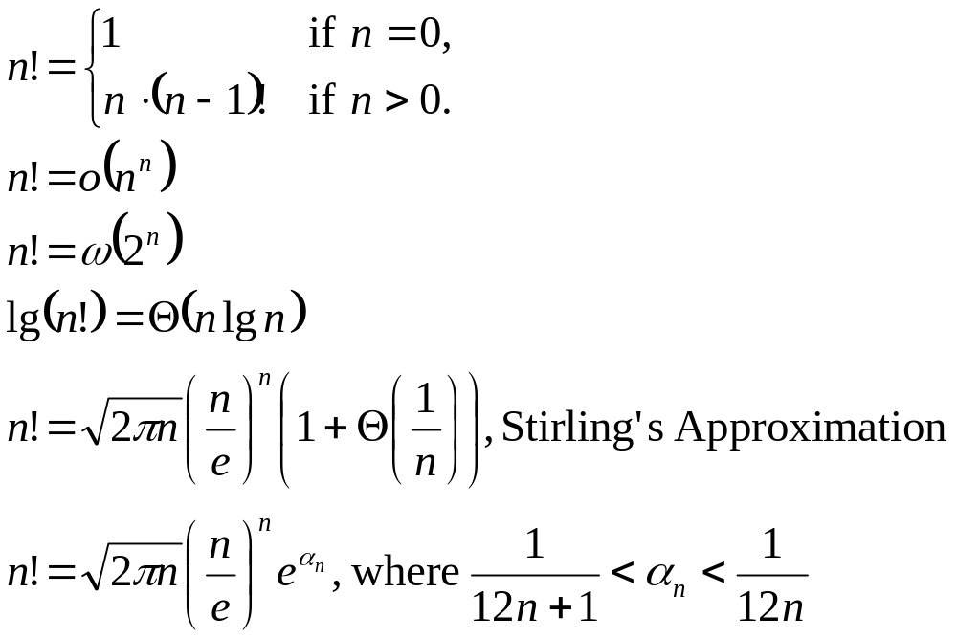
Standard Notations
– Factorials

Slide 20
Standard Notations – etc…
Functional iteration
Iterated logarithm function
Fibonacci numbers

